Slide 1
SAINT MARTIN'S UNIVERSITY LIBRARY ARCHIVE

Slide 2
PROJECT
Saint Martin’s Library is looking at creating a Institutional Repository (IR). The plan is to look at two open source systems to look at for comparison. The two open source IR are ISLANDORA and DSPACE. Each system is used by multiple higher learning institutions.
ISLANDORA:
Florida State
Western Washington University
Oregon State Library
DSPACE:
Pacific Lutheran University (PLU)
Boise State University
Kentucky Department for libraries and archives

Slide 3
CLIENT
Amy Stewart-Mailhiot
Title: Dean of library and learning resources

Slide 4
DSPACE
DSPACE
After meeting with Client it was decided to follow Isolandora and stop all research with Dspace on 1-Nov-2018

Slide 5
ISLANDORA
ISLANDORA is a digital repository system, meaning it is designed to both store and organize information. It is based on Fedora, Drupal, and Solr

Slide 6
ISLANDORA – Key Features - Languages
FEDORA Commons is designed to have digital repositories such as ISLANDORA built upon it.
DRUPALis a content-management system, used as a web application framework for a lot of websites worldwide, and is written in PHP
APACHE SOLR is a search engine written in Java, based on the Apache Lucene project.
It was designed initially by a college library system, the Robertson Library of the University of Prince
Support for any file type (domain agnostic)
There is documentation for learning how to implement ISLANDORA available from the ISLANDORA homepage. With the goal of creating a system that is both easy to implement and simple to learn, this fits our needs very well.

Slide 7
ISLANDORO – Key Features
Support for any file type (domain agnostic)
There is documentation for learning how to implement ISLANDORA available from the ISLANDORA homepage. With the goal of creating a system that is both easy to implement and simple to learn, this fits our needs very well.
Ready available Sandbox for testing and learning

Slide 8
ISLANDORA – Key Features
Support for any file type (Fedora).
Multi-language and functionality support (Drupal).
A modular framework for defining specific data types, including standard audio, PDF, images, paged content, videos, and web archives.
Support for any XML metadata standard, including unique schemas.
Data-entry/editing forms for any XML schema.
Support for the creation of relationships between objects.
A flexible faceted search (Solr).
Automation of the transformation of assets.

Slide 9
How Islandora Stores and Models Content
Everything in Islandora's repository is an Object
Objects are made up of Datastreams
Objects have Relationships to one another
Objects have Persistent Identifiers (PIDs) that are unique in your repository

Slide 10
How Islandora Stores and Models Content
Islandora stores all information in its repository as Objects:
Three types of Objects:
Data Object
Collection Object
Content Model Object.
Objects are comprised of Datastreams:
These are the parts of an Object, e.g. a binary image file, a thumbnail, a metadata stream (such as Dublin Core metadata).
Notes:
The element in a Fedora digital object that represents a content item.
contained metadata
binary files (JPG, PDF, MP3, PNG, TIFF, etc)

Slide 11
Solution Packs
Islandora comes with Solution Packs that bundle tools supporting specific types of content and knowledge domains.
This elegant solution packages the correct standards support, content models, and related tools (such as viewers) for a given content type into modules that can be associated with a collection

Slide 12
Solution Packs types:
Standard Image Solution Pack. Enables support for JPEG, PNG and GIF images.
Large Image Solution Pack. Enables support for TIFF images.
Book Solution Pack. Enables creation of book collections and the ingesting of pages.
Newspaper Solution Pack. Adds support for newspaper collections.

Slide 13
Solution Packs types:
Paged Content Solution Pack. Enables support for paged content.
PDF Solution Pack. Enables support for PDF documents.
Audio Solution Pack. Enables support for WAV and MP3 files.
Video Solution Pack. Enables support for the most popular video formats

Slide 14
Solution Packs types:
Binary/File Solution Pack. Enables support for binary file formats.
Entity Solution Pack. Enables support for Event, Place, Person, and Event authority records.
Digital Humanities (XML) Solution Pack. Enables support for XML documents with tools for textual criticism, documentary editing, and annotation of documents and their images.
Scholar Solution Pack. Enables Institutional repository features such as citations, author pages, etc.

Slide 15
Deployment Options and Implementation Strategies
A service company provides you with a hosted instance of Islandora scaled to your requirements deployed on either your own or a hosted infrastructure.
You choose an Islandora OnDemand cloud instance (SaaS), which is quick but has some limitations on how much customization can be performed.
If your organization has its own IT resources with supporting infrastructure and skills they can obtain Islandora from github and configure an instance for you.

Slide 16
Deployment Options and Implementation Strategies
Both #1 and #2 come with maintenance provisions so your instance is always up-to-date with the latest releases of Islandora (usu. with new functionality).
# 3 requires your IT resources to maintain your instance.
As with deployment you can choose handle as much of your setup as you have resources for. Service providers are available to consult, help with design, configuration, migration, and training. You can contact one here ;).

Slide 17
Islandora Virtual Box Set-up
Our first successful implementation of Islandora.
The Virtual Box setup is aimed at an audience with minimal technical experience.
It functions smoothly, connecting to localhost:8000
It cannot be accessed except from the computer it was installed on, so it is only useful for experimentation.

Slide 18
Islandora Single Site Deployment
Requires a server to house the system.
Windows (Testing only), MacOS, Ubuntu, CentOS, RHEL (Testing only)
Requires creation of SSL Keys and the use of a Domain name.
Successful setup up until the penultimate step, falling short of successfully running the application.

Slide 19
Example Code for Islandora Installation
apt-get update && upgrade
apt-get install -y openssl git htop ntp wget curl nano apt-transport-https ca-certificates software-properties-common
curl -fsSL https://download.docker.com/linux/ubuntu/gpg | sudo apt-key add -
add-apt-repository "deb [arch=amd64] https://download.docker.com/linux/ubuntu $(lsb_release -cs) stable"
apt-get update
apt-get install -y docker-ce
systemctl enable docker && systemctl start docker
curl -L https://github.com/docker/compose/releases/download/1.23.1/docker-compose-`uname -s`-`uname -m` -o /usr/local/bin/docker-compose && chmod +x /usr/local/bin/docker-compose
docker-compose –version
sudo usermod -aG docker $USER
git clone https://github.com/Islandora-Collaboration-Group/ISLE.git
cd ISLE

Slide 20


Islandora Set – up in AWS

Slide 21
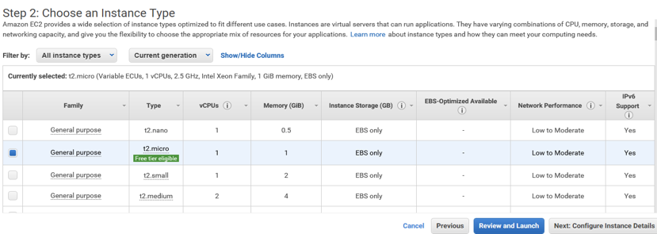

Islandora Set – up in AWS

Slide 22
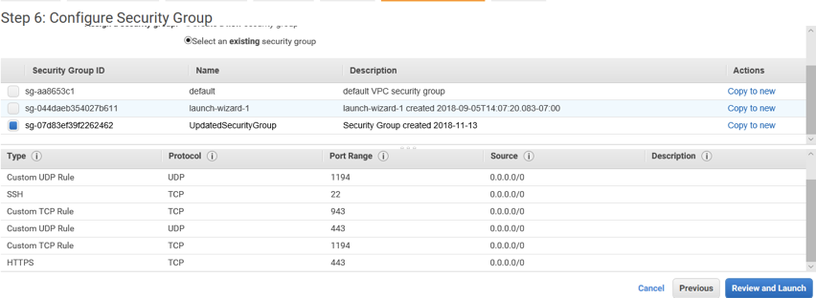

Islandora Set – up in AWS

Slide 23
ISLANDORA Venders support
DISCOVERYGARDEN: Has worked with both universities and public libraries in the past; should be well suited to the type of work we require. Standard Service: $10,000 yearly
AGILE HUMANITIES AGENCY: Open-Source development. Has worked with libraries and universities. Has also collaborated with student programmers working on school projects in the past, may be a great fit for our project.

Slide 24
VENDORS:
1. Agile Humanites
2. Discovery Garden
3. Born Digital

Slide 25
VENDORS: Agile Humanites
Set up and Installation
Our base cost for setup and installation of Islandora 7 along with standard, community supported solution packs on a client-maintained server is $3600 + HST.
This assumes that the client’s institution provides access to a system administrator to facilitate server access and the like. Any institutional branding and theming of the repository would be an additional cost, and these design services can be quoted for you once we have a better sense of the specific system requirements and information architecture for your institutional repository. Our rates for custom design work are $150/h or $1200 per day.

Slide 26
VENDORS: Agile Humanites
Annual services agreement for Islandora. Includes the equivalent of 40 developer hours (at an agency rate of $150/h), with 24 allocated to general maintenance, security updates, and backups, and 16 to minor feature development.
A retainer for services will be billed in advance, with reconciliations done on an annual basis. Any budget remaining at the end of the year will be rolled over to the following year and documented under a new agreement. Reports on services will be issued quarterly.
Includes regularly scheduled general maintenance, security updates, and monthly data backups (client must provide server space for backups). Agreement covers incidental, routine and minor tasks, generally defined as tasks estimated to take 2 work hours or less to complete. May include requests for minor feature development. Tasks estimated to take over 2 hours will be negotiated separately with the client unless it is mutually agreed to apply the required work time to the agreement. Maintenance does not cover server hardware, configurations, or administration, which is the domain of the client’s web host.
40h @ $150/h = $6000 + HST per year
POC Dean Irvin, Director - dean@agilehumanites.ca

Slide 27
VENDORS: Discovery Garden
Questions by Vendor:
Is this a new repository or are you migrating content from an existing system?
What type of content are you storing?
How much content (GB,TB) are you anticipating needing storage for in year 1?
Are you interested in a vendor providing hosting services for your repository?
Do you have any documented requirements you could share?
Answer questions never heard back from them.
Adam Smith Business Development Manager discoverygarden inc. | Managing Digital Content http://www.discoverygarden.ca | 902-367-3851

Slide 28
VENDORS: Born Digital
1. Due to conflicts meeting was never occurred.
Noah W. Smith, Founder + CEO Hadley MA | phone: 413-259-6777 | born-digital.com

Slide 29
Issues:
Change in update during initial set-up causing problems during middile of installation.
Actions trying to correct this

Slide 30
STEPS MOVING FORWARD
Complete the Download of Islander to see completely.
Make comparison of infrastructure for IR:
Storage, minimum of 1.5 TB. Cost for on-site and on the Cloud.
Server cost with institution or again with vendor on the cloud.
More in-depth cost analysis of vendor vs. Organic assets.
Create and check data plan.
Prepare information to request funds from University for implementation.

Slide 31
Questions
Link to Islandora video: https://www.youtube.com/watch?v=hCpktVpfCiw
Training manual
https://webcache.googleusercontent.com/search?q=cache:-BqbAv45giQJ:https://islandora.mnpals.net/pals/islandora/object/PALSrepository%253A345/datastream/OBJ/download/2013_Islandora_Basic_Training_Manual.pdf+&cd=9&hl=en&ct=clnk&gl=us

Slide 32
RESOURCES 1 of 3
Eprints
Electronics & Computer Science, University of Southampton 2018,http://www.eprints.org/uk/, accessed: 1 oct – 7 Dec 2018.
VuFind
Villanova University's Falvey Memorial Library 2018, https://vufind.org/vufind/, accessed: 1 oct – 7 Dec 2018.
INVENIO
CERN 2016-2018, https://invenio-software.org/ , accessed: 1-Oct-7 Dec 2018.
Anjesh Tuladhar, "Digital Library Repository: Invenio vs Dspace", 9-Apr-2018, LinkedIn Corporation,
,https://www.slideshare.net/anjesh/digital-library-repository-invenio-vs-dspace, accessed 5-oct-2018

Slide 33
RESOURCES 2 of
MICHAL KÖKÖRČENÝand AGÁTA BODNÁROVÁ,"Comparison of digital libraries systems", ADVANCES in DATA NETWORKS, COMMUNICATIONS, COMPUTERS.,http://wseas.us/e-library/conferences/2010/Faro/DNCOCO/DNCOCO-16.pdf, accessed: 4-Oct-2018
https://wiki.duraspace.org/display/ISLANDORA/Getting+Started+with+Islandora
https://webcache.googleusercontent.com/search?q=cache:-BqbAv45giQJ:https://islandora.mnpals.net/pals/islandora/object/PALSrepository%253A345/datastream/OBJ/download/2013_Islandora_Basic_Training_Manual.pdf+&cd=9&hl=en&ct=clnk&gl=us

Slide 34
RESOURCES 2 of
https://aws.amazon.com/ec2/?sc_channel=PS&sc_campaign=acquisition_US&sc_publisher=bing&sc_medium=ACQ-P%7CPS-BI%7CBrand%7CDesktop%7CSU%7CCompute%7CEC2%7CUS%7CEN%7CText&sc_content=ec2_p&sc_detail=ec2&sc_category=Compute&sc_segment={creative}&sc_matchtype=p&sc_country=US&s_kwcid=AL!4422!10!71949349564215!71949660862469&ef_id=W4BI7QAAAI3QQW3M:20181209075713:s
https://aws.amazon.com/
https://duraspace.org/dspace/

Slide 35
RESOURCES 2 of
https://aws.amazon.com/ec2/?sc_channel=PS&sc_campaign=acquisition_US&sc_publisher=bing&sc_medium=ACQ-P%7CPS-BI%7CBrand%7CDesktop%7CSU%7CCompute%7CEC2%7CUS%7CEN%7CText&sc_content=ec2_p&sc_detail=ec2&sc_category=Compute&sc_segment={creative}&sc_matchtype=p&sc_country=US&s_kwcid=AL!4422!10!71949349564215!71949660862469&ef_id=W4BI7QAAAI3QQW3M:20181209075713:s
https://aws.amazon.com/
https://duraspace.org/dspace/

